Slide 1
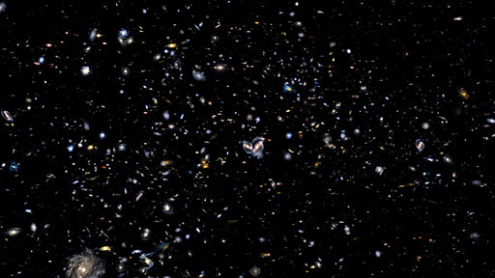
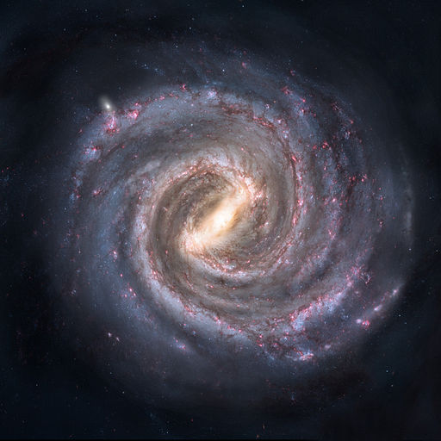
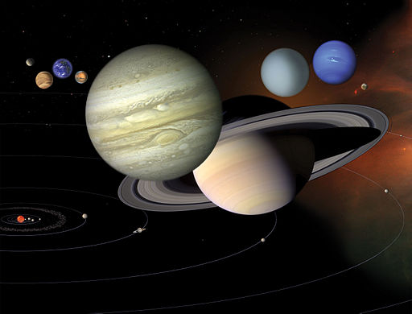
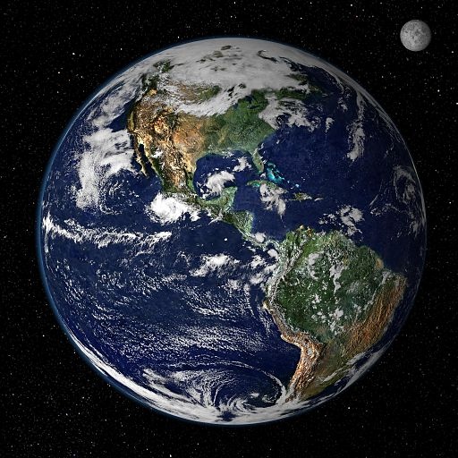
Plaid Pete is Finding Earth’s Place in the Universe Info Graphics Lesson 2
The Universe
Milky Way
Galaxy
The Solar
System
Earth

Slide 2
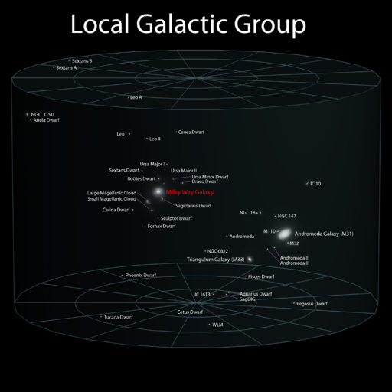
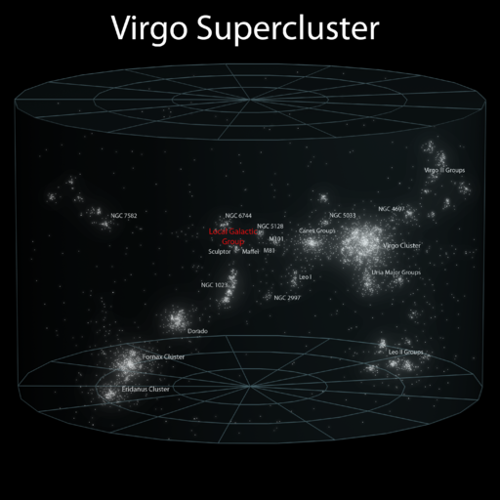
Plaid Pete is Finding Earth’s Place in the Universe – Lesson 2
Info Graphics
Local Galactic
Group
Local Galactic Group by Andrew Z. Colvin is
licensed under Creative Commons 3.0.
Virgo
Supercluster
Virgo Supercluster by Andrew Z. Colvin is
licensed under Creative Commons 3.0.

