Slide 1
Producer
A living thing, such as a plant, that can makes its own food

Slide 2
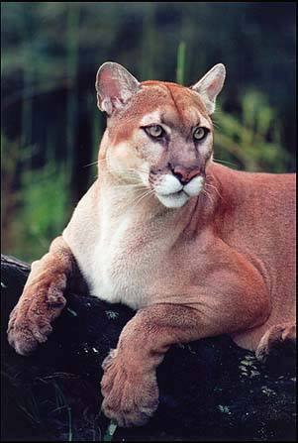
Consumer
A living thing that can’t make its own food and must eat other living things.

Slide 3
Herbivore
An animal that eats only plants or producers.

Slide 4
Carnivore
An animal that eats only other animals.

Slide 5
Omnivore
An animal that eats both plants and other animals

Slide 6
Decomposer
A living thing that feeds on the wastes and remains of plants and animals

Slide 7
Habitat
An environment that meets the needs of an organism

Slide 8
Niche
The role of an organism in its habitat

Slide 9
A series of organisms that depend on one another for food

Slide 10
Prey
Consumers that are eaten by predators

Slide 11
Predators
A consumer that eats prey

Slide 12
Food Web
A group of food chains that overlap

Slide 13
Energy Pyramid
A diagram showing how much energy is passed
form one organism to the next in a food chain

