Slide 1
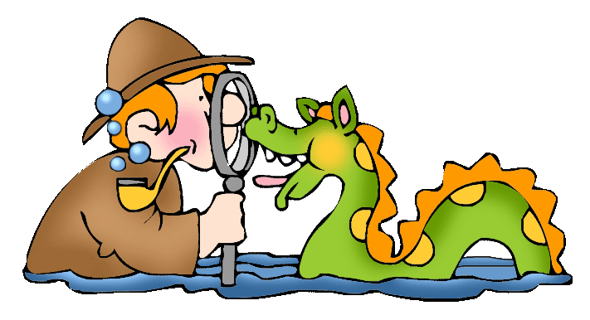
Animal Adaptations
Web quest Project for
Fourth Grade

Slide 2
Introduction
Introduction
ATTENTION all scientists! Your expertise is needed. The planet Earth is in need of more animal species. Your mission is to create a new animal to live anywhere on earth. Your job is to learn as much information about animal adaptations as you can. You will learn that each animal has 5 basic needs to survive: getting food/water, oxygen, maintaining body temperature, protection/defense, and making/finding shelter. As you create your animal, make sure it has the essential body parts that allows the animal to meet their 5 basic needs. You will be sharing your animal with your classmates at the end of the webquest.

Slide 3
Task
The Task
Your task is to create a new animal and explain in detail how all adaptations are being used for the animal.
Choose an animal to research adaptations.
Visit various sites to research animal’s diet, behavior, appearance, structures and habitats.
Complete ROLE sheet.
Get with your group and brainstorm a new animal species using what you have learned from your research.
Create a PowerPoint presentation giving information about your made up animal and its adaptations.
Present your PowerPoint to the class.
Draw a picture of your new animal species.

Slide 4
PROCESS
The Process
1. First you'll be assigned to a team of 4 students.
2. You will each be responsible for one of the roles that follow as you research an animal.
The nutritionist will research the diet of the animal.
The psychologist will study the animals’ behavior and appearance.
The engineer will study the structures of the animal and how these allow it to live in its habitat.
The environmentalist will study the habitat of the animal.
3. When you are researching, choose an animal that you all agree upon and that has the same habitat as the animal your group will create.

Slide 5
WEBSITES TO HELP
Websites for research
Animals on Defense
Examples of Animal Adaptations
More Information on Animal Adaptations
Animal Habitats
National Geography Kids
Desert Animals Adaptations
Make me a genius video

Slide 6
Jobs
4. You will need to take notes about your animal as you research. Use role sheets provided below to record your information
Engineer
Environmentalist
Nutritionist
Psychologist

Slide 7
Now the Fun Begins
5. Now that you have learned about an animal and its adaptations that help it survive its habitat, it's time to put your creative hats on and create your animal based on what you have learned.
6. Use these same roles as you create your animal. Make sure you can explain how the animals’ adaptations would help it survive.
Storyboard to use to help plan your power point

Slide 8
Project
You will create a Power Point or any digital presentation you like with your group.
It should include:
A title page with the name of your animal and each of your names on it from your group.
A page created by each person based on their role.
Any interesting facts you want us to know about your new animal for planet Earth.
Draw a picture of your group’s new animal species

Slide 9
Rubric & Source Due February
Rubric
This project is thanks to Melissa Biehl and Amanda Lewis
http://www.pkwy.k12.mo.us/bellerive/homepages/assignment.cfm?UserID=belfourth&TeacherCourseID=900B6AA8-1CC4-EACA-CEA745B90C73CDBB

